Slide 1



Analysis of Algorithms
Presentation for use with the textbook Data Structures and Algorithms in Java, 6th edition, by M. T. Goodrich, R. Tamassia, and M. H. Goldwasser, Wiley, 2014
Input
Algorithm
Output

Slide 2
The "Big-Oh" Notation
4.3.1

Slide 3
Big-Oh Notation 1
Given functions f(n) and g(n), we say that f(n) is O(g(n)) if there are positive constants c and n₀ such that
f(n) ≤ cg(n) for n ≥ n₀

Slide 4
Big-Oh Notation 2
Example: 2n + 10 is O(n)
2n + 10 ≤ cn
(c − 2) n ≥ 10
n ≥ 10/(c − 2)
Pick c = 3 and n₀ = 10

Slide 5
Big-Oh Example
Example: the function n² is not O(n)
n² ≤ cn
n ≤ c
The above inequality cannot be satisfied since c must be a constant

Slide 6
More Big-Oh Examples 2
3 n³ + 20 n² + 5
3 n³ + 20 n² + 5 is O(n³)
need c > 0 and n₀ ≥ 1 such that 3 n³ + 20 n² + 5 ≤ c n³ for n ≥ n₀
this is true for c = 4 and n₀ = 21

Slide 7
More Big-Oh Examples 3
3 log n + 5
3 log n + 5 is O(log n)
need c > 0 and n₀ ≥ 1 such that 3 log n + 5 ≤ c log n for n ≥ n₀
this is true for c = 8 and n₀ = 2

Slide 8
Big-Oh and Growth Rate
The big-Oh notation gives an upper bound on the growth rate of a function
The statement “f(n) is O(g(n))” means that the growth rate of f(n) is no more than the growth rate of g(n)
We can use the big-Oh notation to rank functions according to their growth rate
 | f(n) is O(g(n)) | g(n) is O(f(n))
g(n) grows more | Yes | No
f(n) grows more | No | Yes
Same growth | Yes | Yes

Slide 9
Big-Oh Rules
If is f(n) a polynomial of degree d, then f(n) is O(n^{d}), i.e.,
Drop lower-order terms
Drop constant factors
Use the smallest possible class of functions
Say “2n is O(n)” instead of “2n is O(n²)”
Use the simplest expression of the class
Say “3n + 5 is O(n)” instead of “3n + 5 is O(3n)”

Slide 10
Asymptotic Algorithm Analysis 1
The asymptotic analysis of an algorithm determines the running time in big-Oh notation
To perform the asymptotic analysis
We find the worst-case number of primitive operations executed as a function of the input size
We express this function with big-Oh notation

Slide 11
Examples of Algorithm Analysis
4.3.3

Slide 12
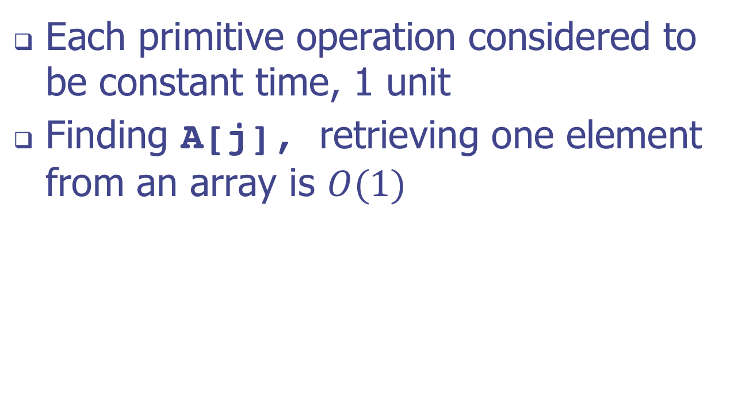
Constant Time Operations
Each primitive operation considered to be constant time, 1 unit
Finding A[j], retrieving one element from an array is $O(1)$

Slide 13
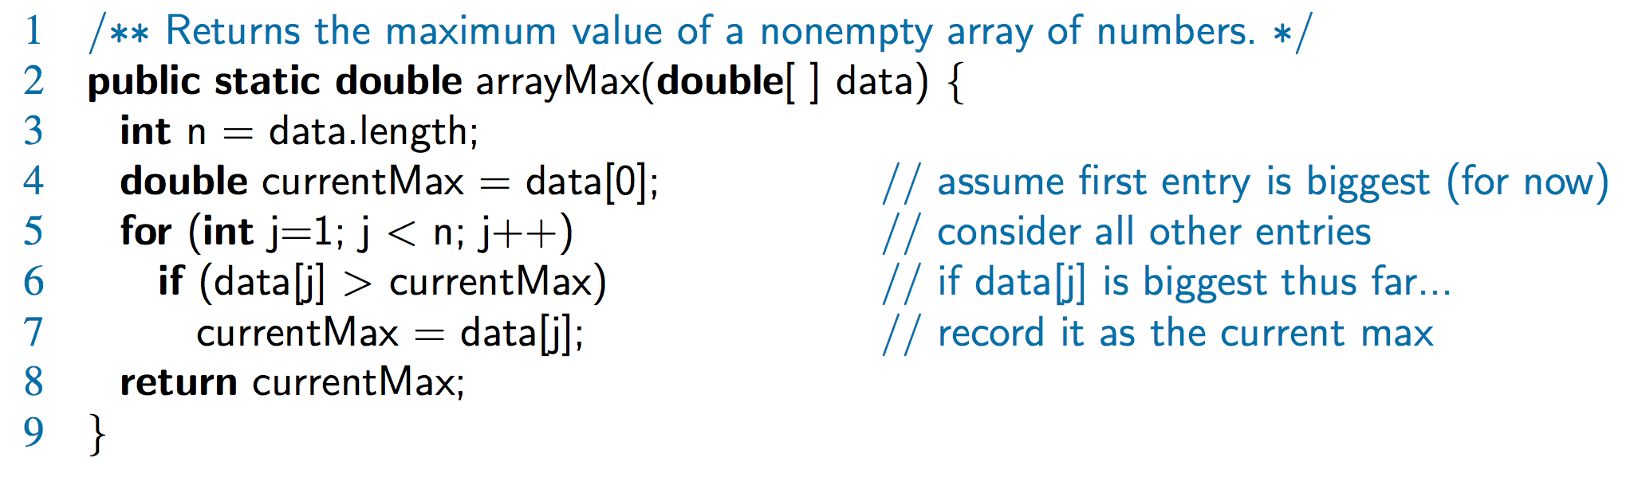

Finding the Maximum of an Array
Algorithm arrayMax executes 5n + 5 primitive operations in the worst case
Runs in linear time: $O(n)$

Slide 14
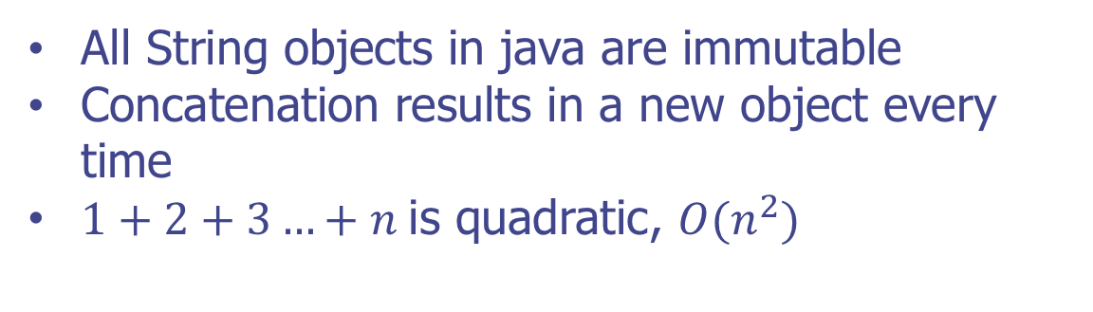
Composing Long Strings
All String objects in java are immutable
Concatenation results in a new object every time
$1+2+3…+n$is quadratic, $O(n^{2})$

Slide 15

Composing Long Strings
Using java StringBuilder does not create a new object every time
Composing a new string is $O(n)$

Slide 16
Three-way Set Disjointness
Given three sets of integers, A, B, and C, stored in three arrays
No duplicates within an array
Some numbers may be in 2 or 3 sets

Slide 17
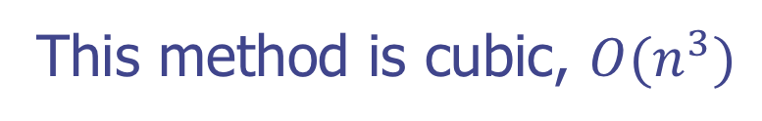
Three-way Set Disjointness
Method 1: Nested loops with A, B and C
(compare all a, b, and c combinations)
This method is cubic, $O(n^{3})$

Slide 18
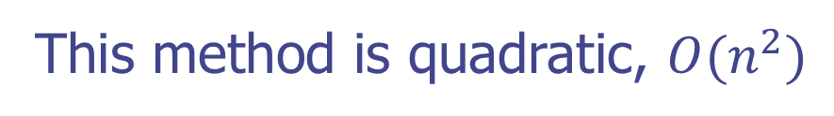
Three-way Set Disjointness
Method 2: Match a and b first, then look for matching c
This method is quadratic, $O(n^{2})$

Slide 19
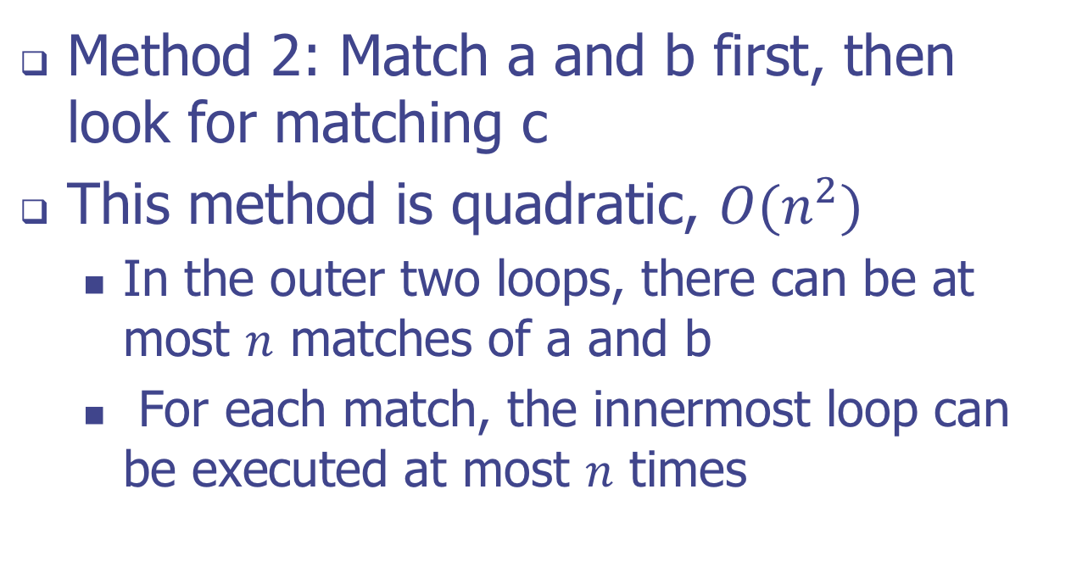
Three-way Set Disjointness
Method 2: Match a and b first, then look for matching c
This method is quadratic, $O(n^{2})$
In the outer two loops, there can be at most $n$ matches of a and b
For each match, the innermost loop can be executed at most $n$ times

Slide 20
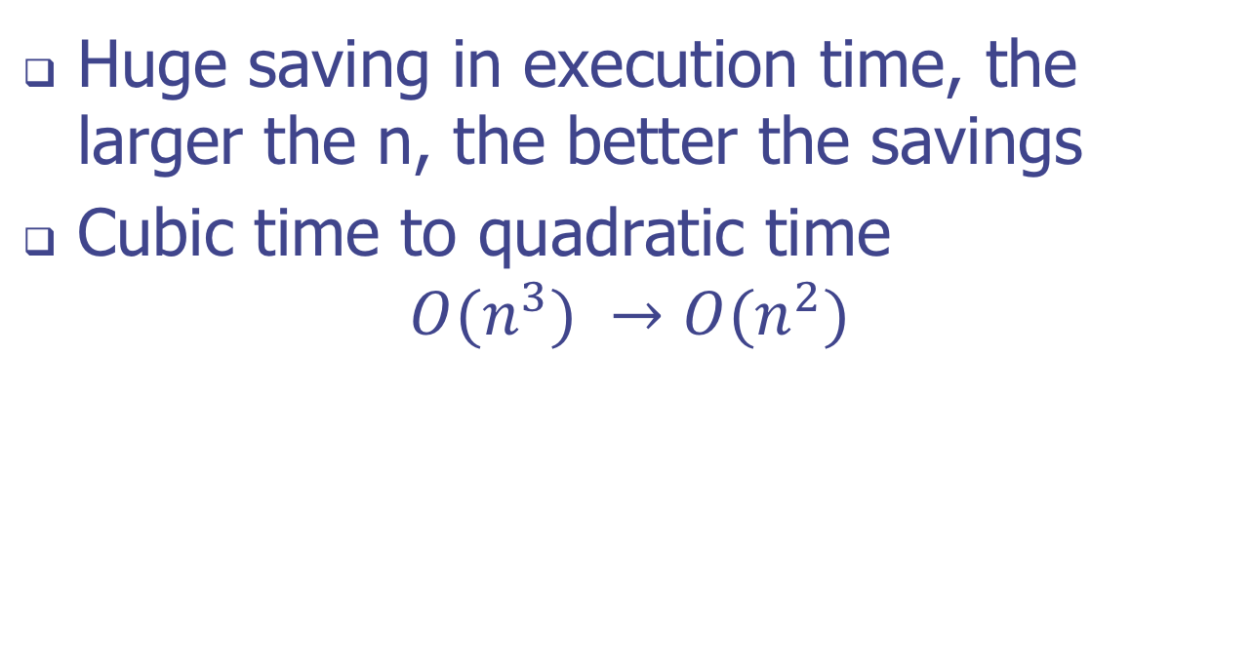
Three-way Set Disjointness
Huge saving in execution time, the larger the n, the better the savings
Cubic time to quadratic time $O(n^{3}) →O(n^{2})$

Slide 21
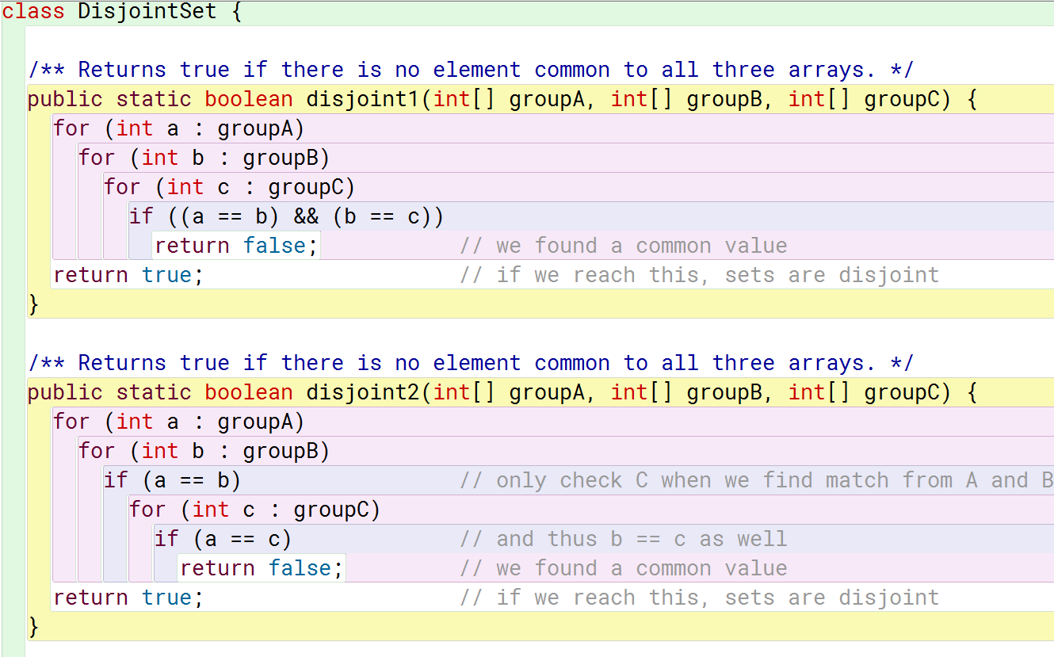
DisJointness Sample Code

Slide 22
Element Uniqueness Problem
Given an array of n elements, are all elements different from each other?
Nested loop, comparing all data[j]==data[k]

Slide 23
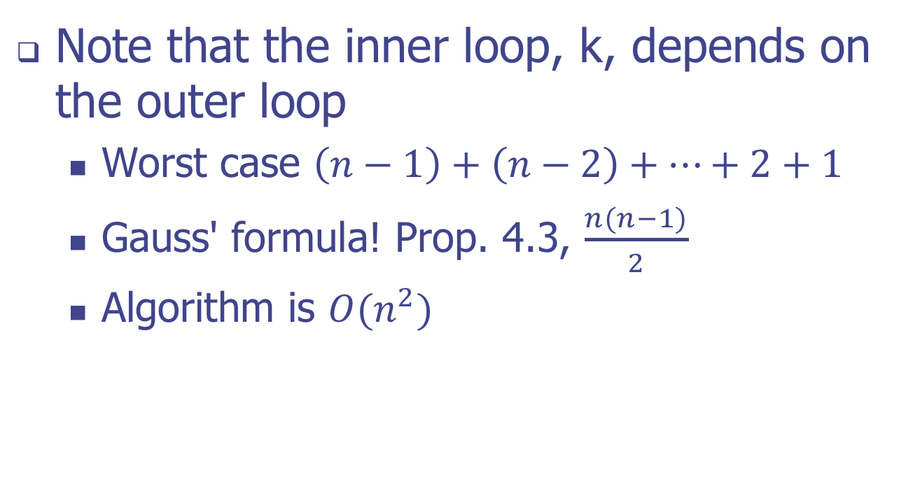
Element Uniqueness Problem
Note that the inner loop, k, depends on the outer loop
Worst case $\left(n−1\right)+\left(n−2\right)+…+2+1$
Gauss' formula! Prop. 4.3, $\frac{n(n−1)}{2}$
Algorithm is $O(n^{2})$

Slide 24
Using Sorting as a Problem-Solving Tool
But suppose we sort the data first?
Copy the array and sort first, Arrays.sort()
Then just compare element j with j+1

Slide 25
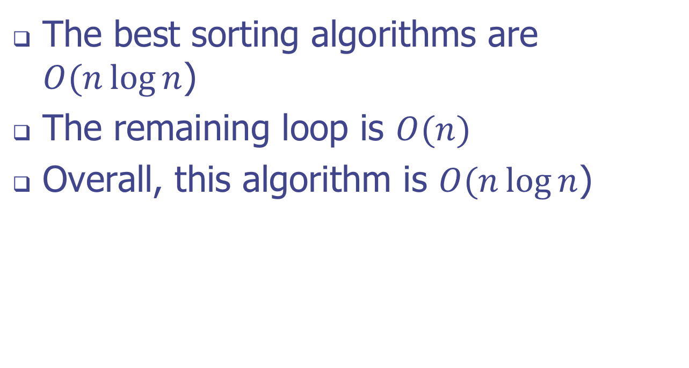
Using Sorting as a Problem-Solving Tool
The best sorting algorithms are $O(n\log{n}$)
The remaining loop is $O(n)$
Overall, this algorithm is $O(n\log{n}$)

Slide 26
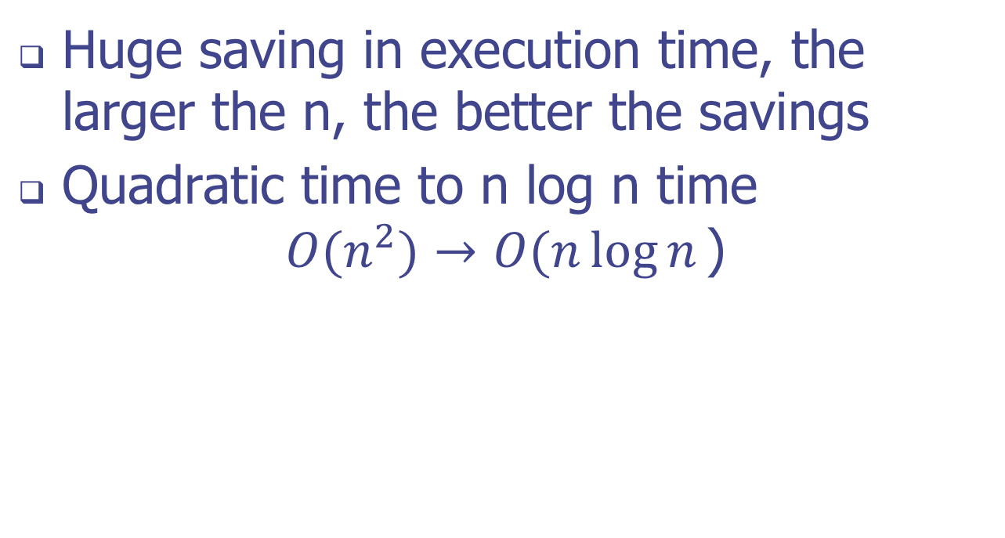
Uniqueness Problem / Using Sorting as a Problem-Solving Tool
Huge saving in execution time, the larger the n, the better the savings
Quadratic time to n log n time $O(n^{2})→O(n\log{n}\text{)}$

Slide 27
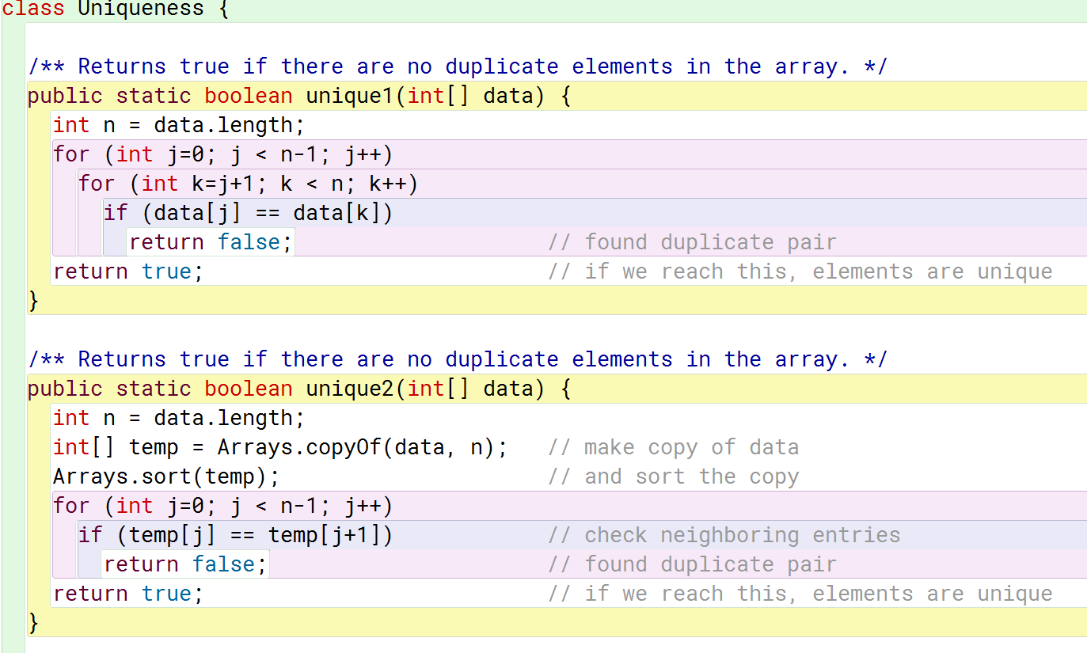
Uniqueness Sample Code

Slide 28
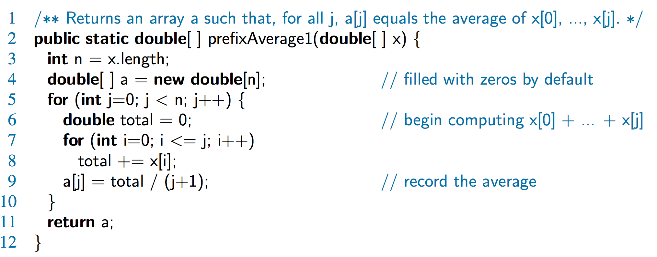
Prefix Averages (Quadratic)
The following algorithm computes prefix averages in quadratic time by applying the definition

Slide 29
Arithmetic Progression
The running time of prefixAverage1 is O(1 + 2 + …+ n)
The sum of the first n integers is n(n + 1) / 2
There is a simple visual proof of this fact
Thus, algorithm prefixAverage1 runs in O(n²) time

Slide 30
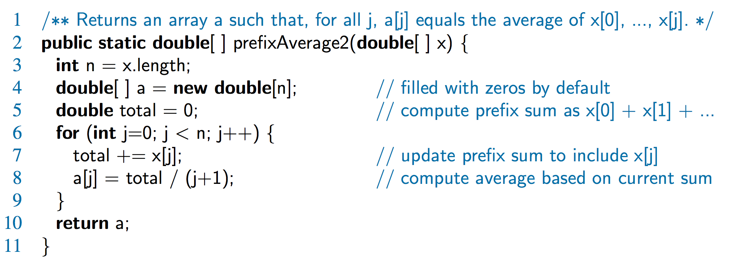
Prefix Averages 2 (Linear)
The following algorithm uses a running summation to improve the efficiency
Algorithm prefixAverage2 runs in O(n) time!

Slide 31
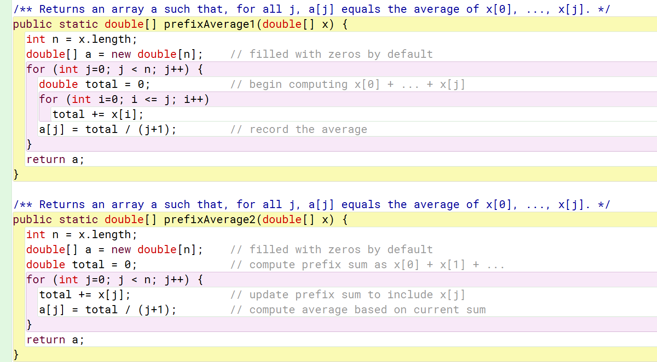
Prefix Averages Sample Code

